Slide 1






Winning the 1X World Model Challenge
Generative World Modelling for Humanoids
Team Revontuli
Aidan Scannell*, Riccardo Mereu*, Yuxin Hou, Yi Zhao,
Aditya Jitta, Antonio Dominguez, Luigi Acerbi, Amos Storkey, Paul Chang
*Equal contribution

Slide 2

World Models
World Model
f: State x Action -> Next State Distribution
Model Class | Training Data | Controllability | Examples
World Model | Video + Actions | Frame Level | e.g. GAIA-2
Video Model | Video + Text | Video Level | e.g. Veo 2
Notes:
A world model is a learned representation of how the world evolves in response to an agent’s behavior
WM are virtual simulators trained from real-world video and sensor/actuator data
Given past frames and actions, it imagines future outcomes

Slide 3
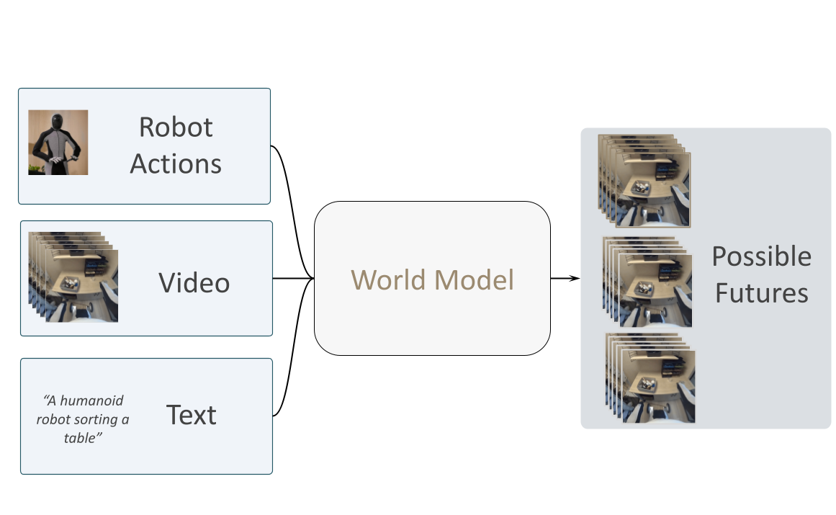
World Model
“In machine learning, a world model is a computer program that can imagine how the world evolves in response to an agent’s behavior”
Notes:
But before diving into the solutions. Let’s clarify what we mean as a world model in this context. A WM can be defined as a program that can imagine how the world evolves based on an agent behaviour. In practical terms WMs are virtual simulators, learnt directly on collected data, that takes as input observations of the real world and the actions the agent will perform and produce as different potential outcomes.
WM are virtual simulators trained from real-world observations and actions
Given past frames and actions, it imagines future outcomes

Slide 4
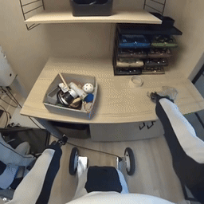
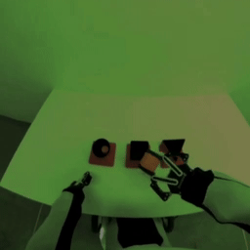
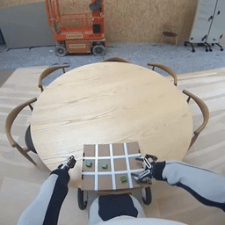
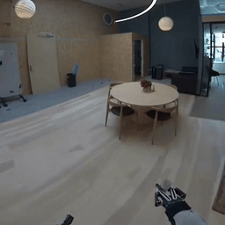
1X World Model Challenge
Challenges Track:
Compression Track
Sampling Track
Dataset: 100h videos collected with 1X EVE Humanoid Robots
Notes:
To , 1X released the 100 hours long data

Slide 5
Compression Track

Slide 6
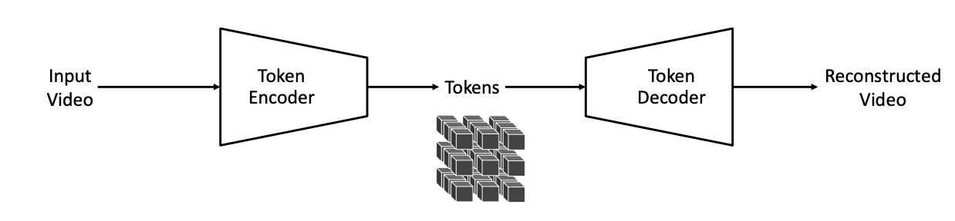
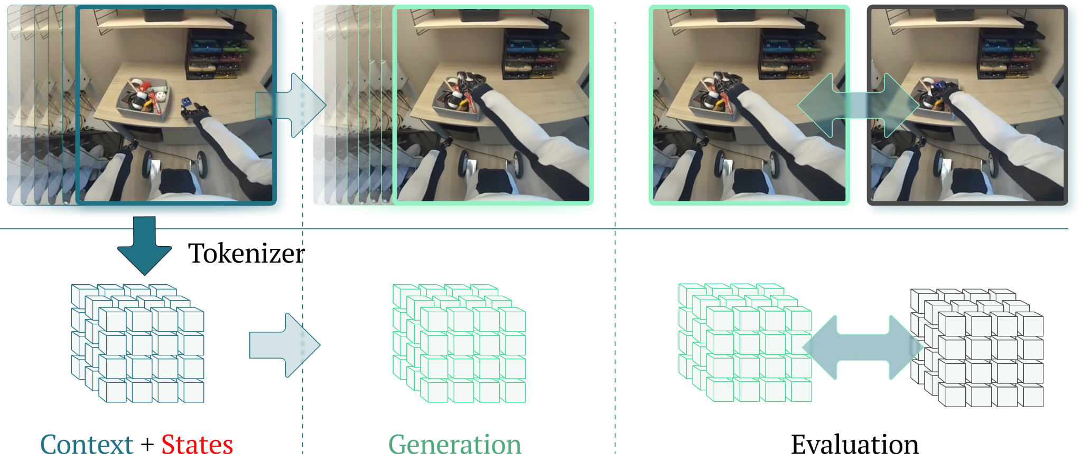
Compression Task
1. Compress videos 34x512x512 to discrete tokens 6x32x32
2. World modelling in discrete latent space
Cosmos 8x16x16 tokenizer

Slide 7
Compression Task
Context + Actions
Past tokens (3x32x32)
Robot actions (34x25)
Future tokens (3x32x32)

Slide 8

Architecture: ST-Transformer
T=3:5
Spatio-temporal Transformer
Robot Actions
32x32
T=0:2
Notes:
Spatial attention 1x32x32
Temporal attention Tx1x1
Positional info via learnable absolute embeddings over space and time

Slide 9



Memory Complexity
Tokens per sample: 5x32x32=5,120
  T=5: number of time steps
  S=1024: number of spatial locations
Full attention memory complexity scales with
Spatio-temporal attention scales with
Method | Memory Complexity | Relative Cost
Full Attention |  | 100%
Spatio-temporal Attention |  | 20%
Notes:
Dominating factor scales linearly with number of frames instead of quadratically

Slide 10
Architecture: ST-Transformer
Spatial Attention
Temporal Attention
Robot Actions
L Layers
MLP
Conv
Embed
Layer Norm
Layer Norm
FFN
Layer Norm
Layer Norm
Linear
Absolute Positional Embedding
(B, T), S, D
(B, S), T, D
Notes:
Action conditioning via additive embeddings like Genie
Positional info via learnable absolute embeddings over space and time
Spatial attention 1x32x32
Temporal attention Tx1x1
Each color represents a single self-attention map

Slide 11
Results
 | CE Loss [↓] |  | Rank
Team | Test | Val
Revontuli | 6.64 | 4.92 | 1st
Duke | 7.50 | 5.60 | 2nd
a27sridh | 7.99 | – | 3rd
We won! Best test loss!
But…
Generations were often blurry.
Limited data: only 100h of video
Can we leverage prior information from video models pre-trained on internet-scale video?
Notes:
To , 1X released the 100 hours long data

Slide 12
Sampling Track

Slide 13
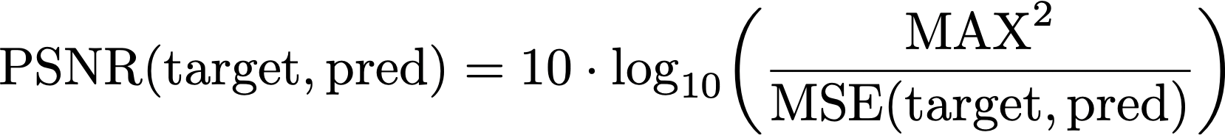
Sampling Task
Input: 17 frames and 77 robot actions
Evaluation: PSNR between 77th predicted frame and ground truth

Slide 14
Sampling Task
Can we leverage prior information from pre-trained video models?
-> Wan 2.2 TI2V-5B
What is the best way to fine-tune on 1X dataset and add action-conditioning?

Slide 15
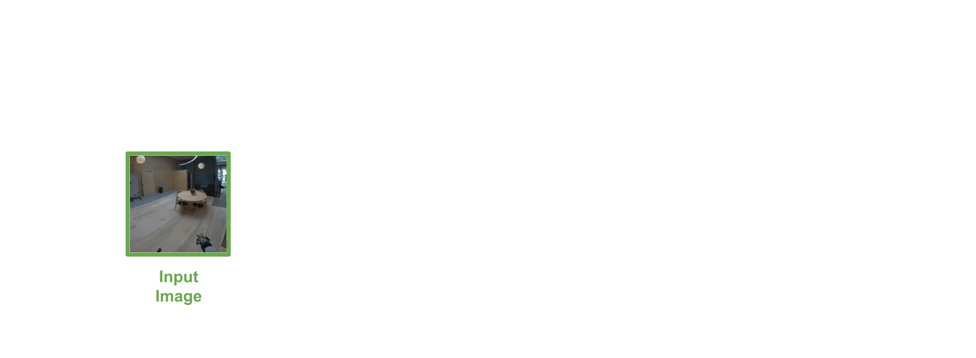
Wan 2.2 TI2V-5B

Slide 16
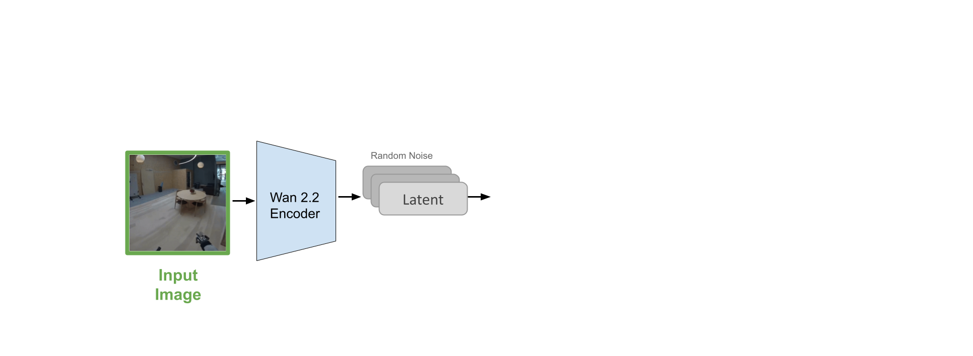
Wan 2.2 TI2V-5B

Slide 17
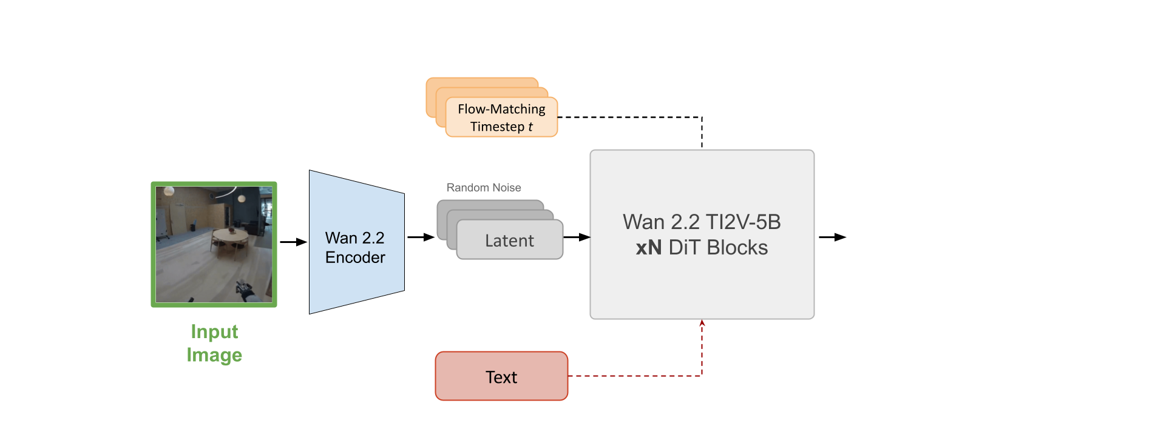
Wan 2.2 TI2V-5B

Slide 18
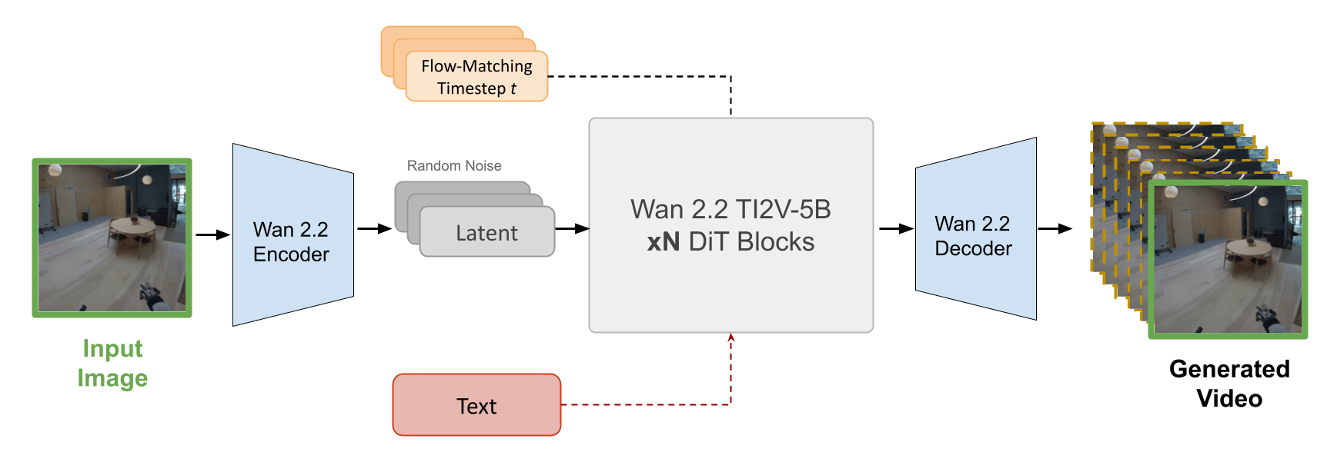
Wan 2.2 TI2V-5B

Slide 19
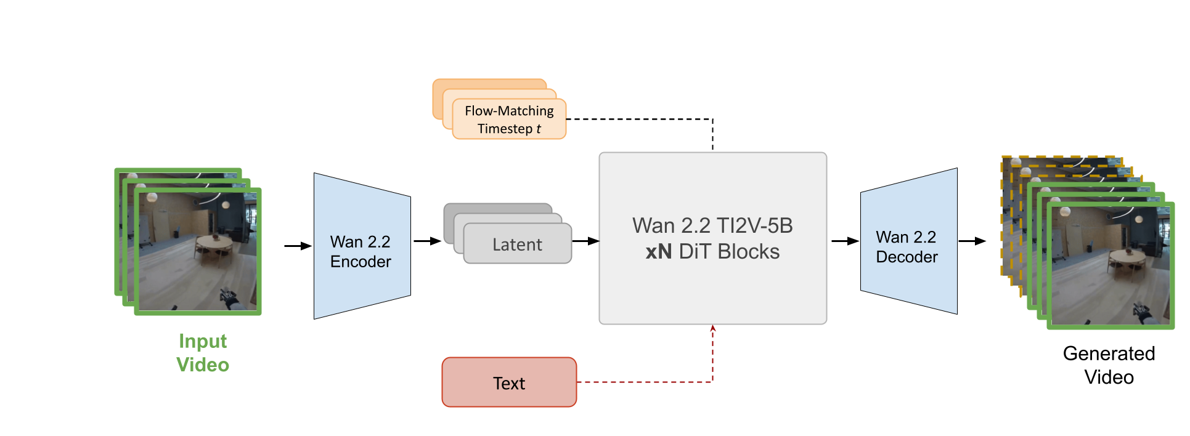
Add Video Conditioning
Random Noise

Slide 20
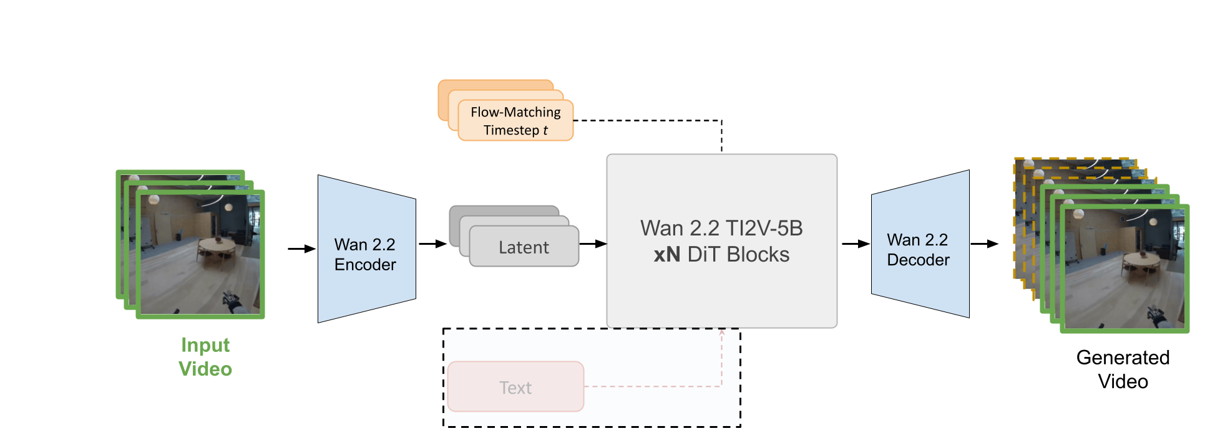
2. text_prompt = “”

Slide 21
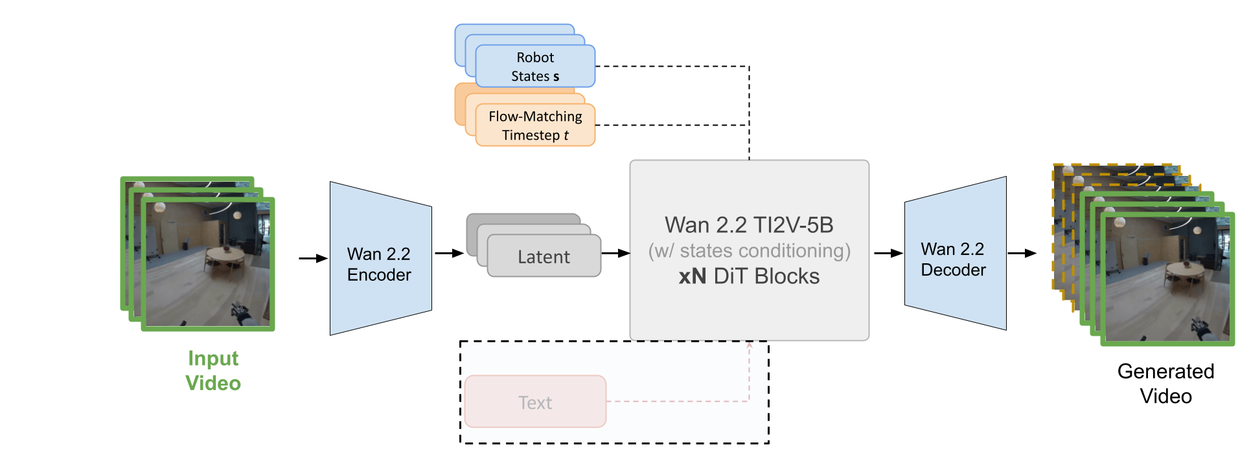
3. Add Robot Action Conditioning
Robot Actions a

Slide 22
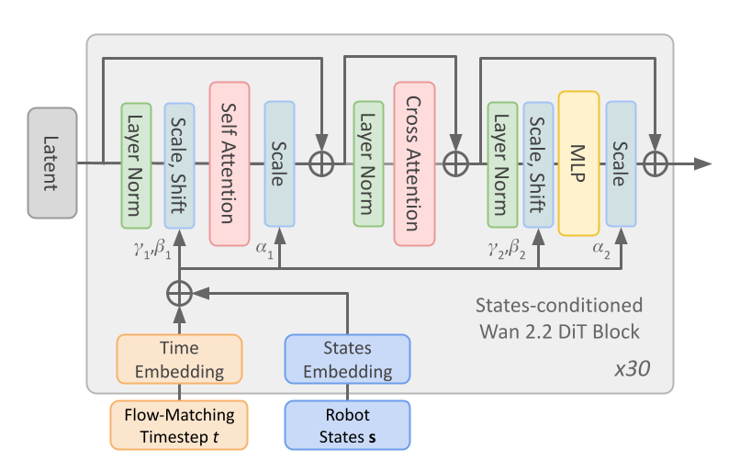
DiT Block: Action Conditioning
Flow Matching timestep t -> AdaLN
Robot’s actions a -> AdaLN-Zero
Action Embedding
Robot Actions a

Slide 23

Real vs. Generated Videos
GT Video
Generated Video
Notes:
- Complex scenes
- Deformable objects
- Model physics of the environment

Slide 24
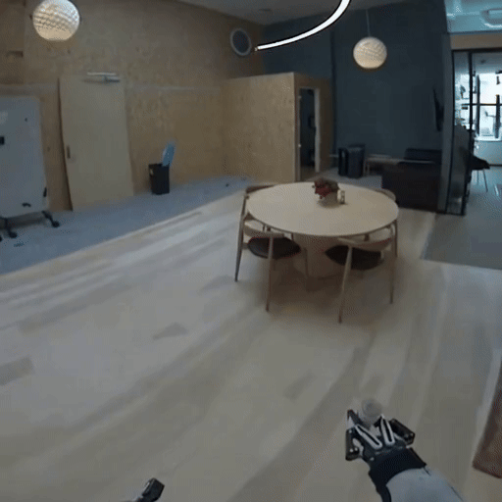
Real vs. Generated Videos
GT Video
Generated Video
Notes:
- WM has to deal with movement of the robot within the environment
- Conditioning may not have information about the entire room

Slide 25
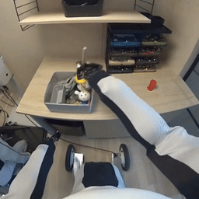


Failure Modes
GT Video
Generated Video
GT Video
Generated Video
Object Coherence
Color Consistency

Slide 26
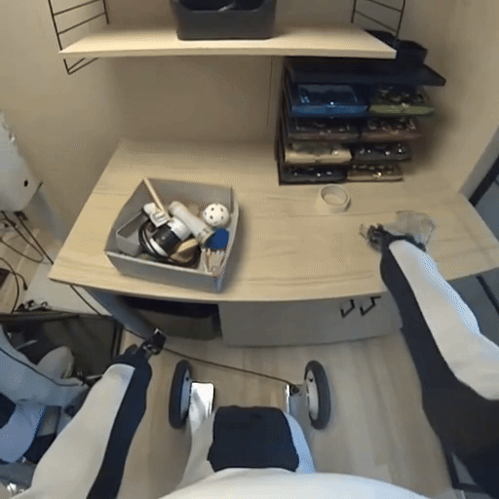
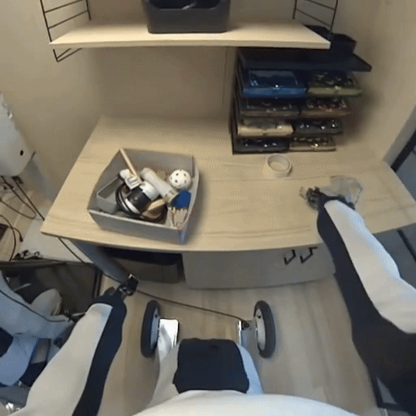
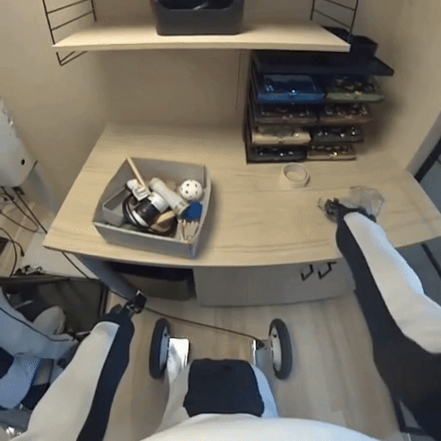



Inference Ensemble Approach
Use the model to make multiple predictions
Captures the uncertainty
Averages out complicated areas in the generated frames
…
Ensemble Prediction
GT Video
Generate N samples

Slide 27
 | PSNR [dB] [↑] |  | Rank
Team | Test | Val
Revontuli | 23.04 | 25.53 | 1st
Duke | 21.56 | 25.30 | 2nd
Micheal | 18.51 | – | 3rd

Slide 28
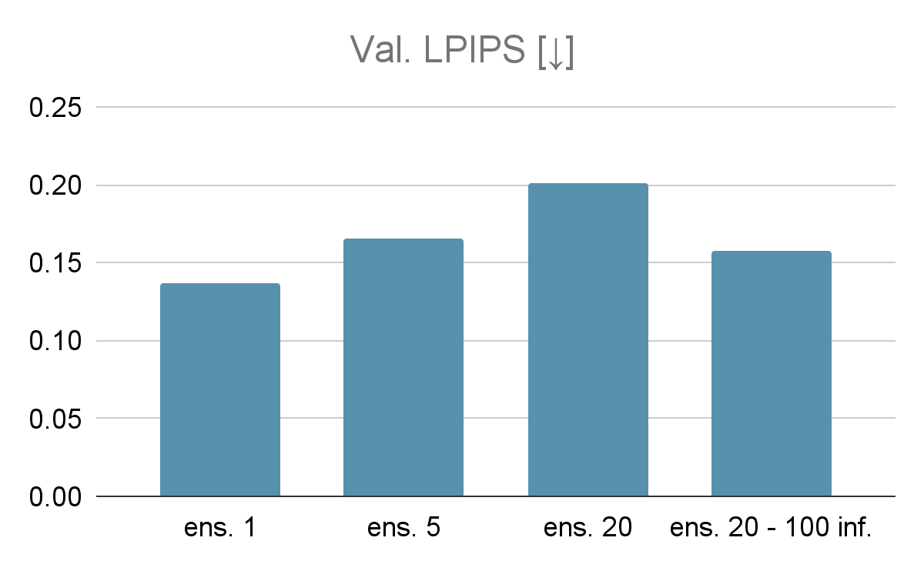
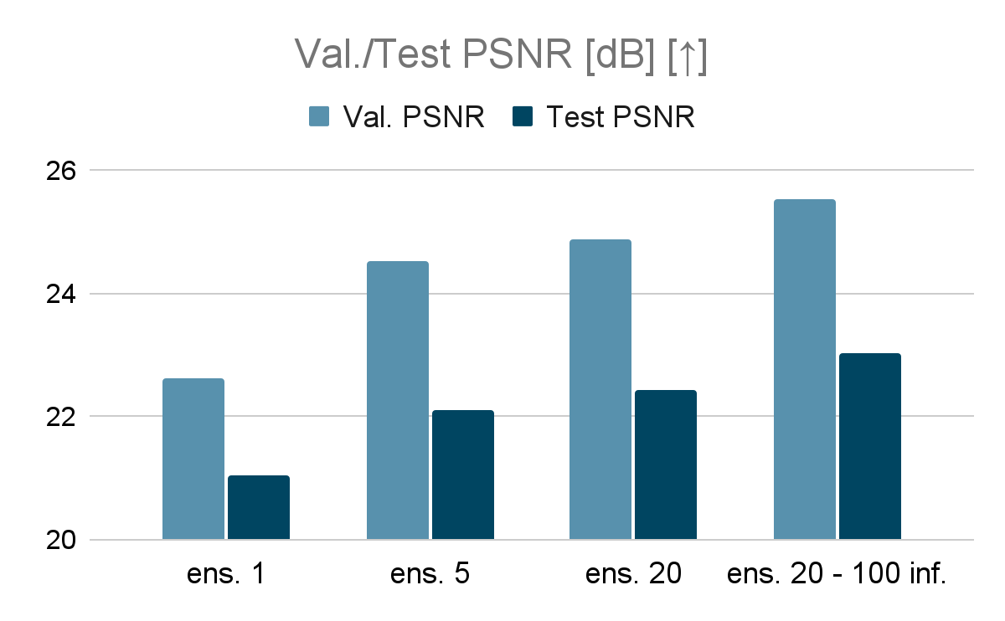
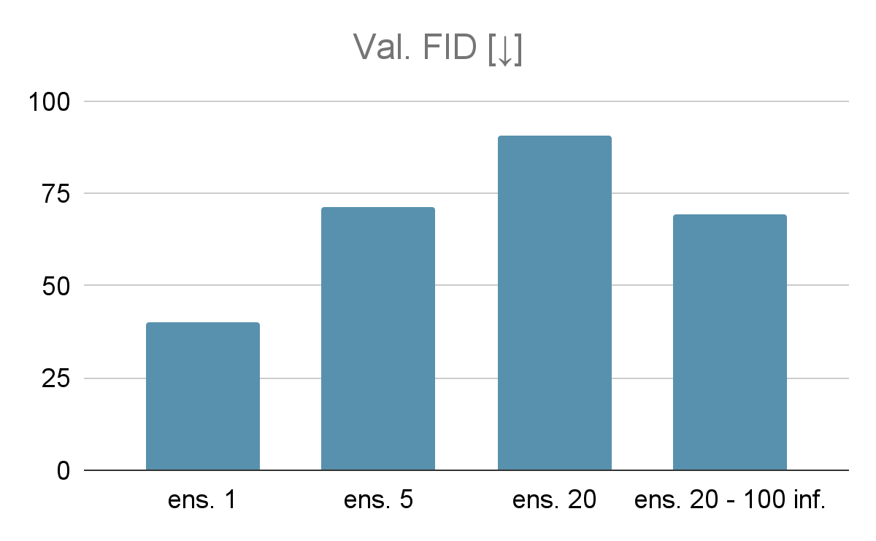
Quantitative Comparison
TL;DR: increasing the number of ensemble samples leads go less realistic videos, but achieves better PSNR.

Slide 29
Outlook
Pre-trained video models are a good prior for world models.
But…
We need better methods for evaluating world models.
How can we make video world models obey the laws of physics?
  Objects cannot teleport, conservation of momentum, etc
We don’t have internet-scale video data with actions,
  What is the best way to pre-train on video, such that we can fine-tune to get an action-conditioned world model?
Notes:
To , 1X released the 100 hours long data

Slide 30
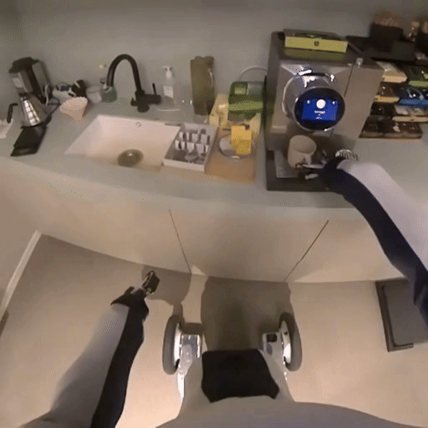
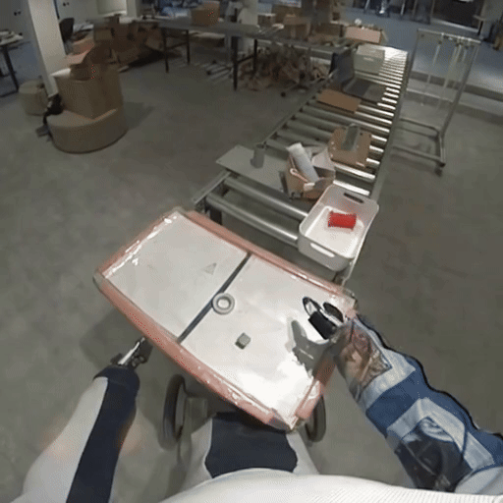
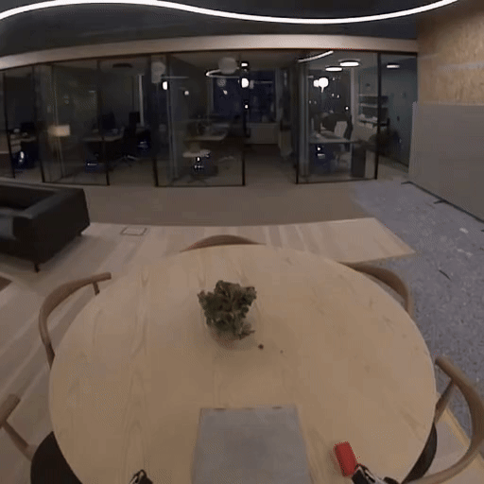

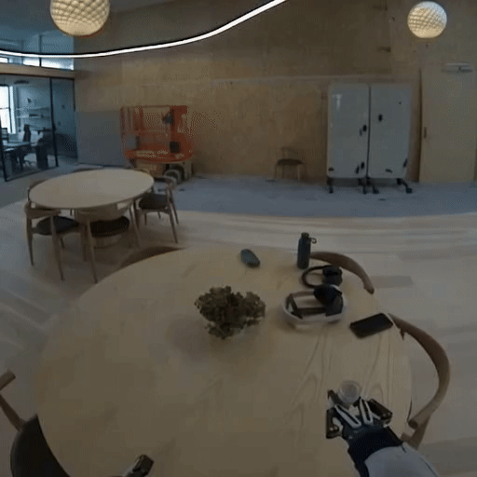
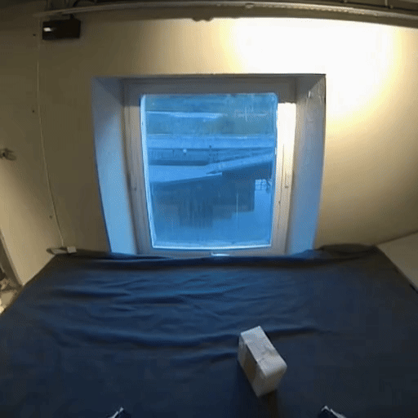
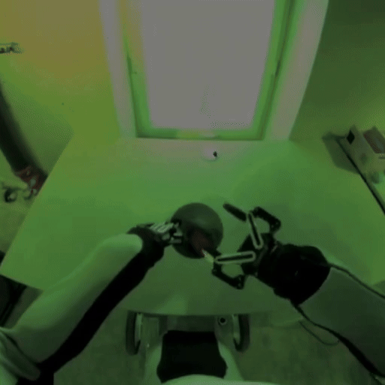
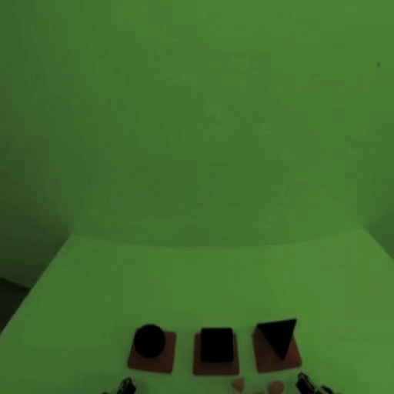
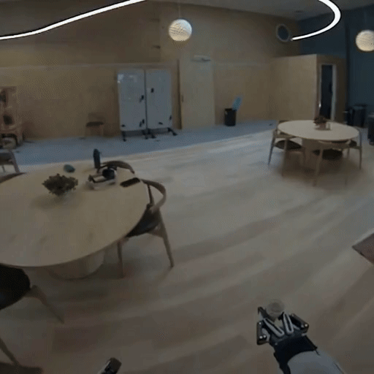
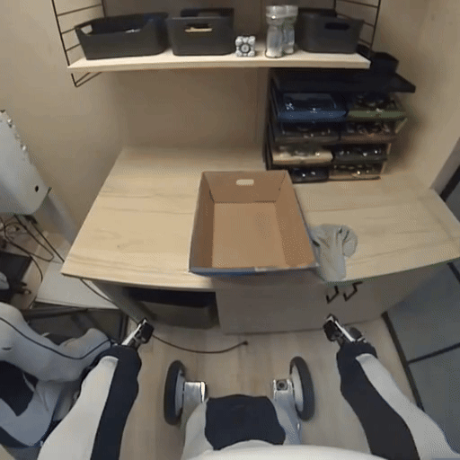

Thanks for listening!
Contacts:
aidan.scannell@ed.ac.uk
Technical report

